Slide 1

Exploring Feature Importance in Predicting Music Preference
Jackie Zhou
400186858
Department of Psychology, Neuroscience & Behaviour
Friday, December 6, 2024
Notes:
Hi everyone, my name is Jackie and today I will be talking about feature importance in predicting music preference

Slide 2
Outline
Introduction + Motivation
Data: Free Music Archive
Methods
  Principal Components Analysis
  Regression Analyses: Random Forest and Boosting
Results
  Regression Models Comparison
  PCA Feature Loadings
Discussion
Notes:
As a general outline, I’ll be going over intro and motivation, my dataset, two-part methods, results and comparisons, and then discussions.

Slide 3
Introduction + Motivation
Music popularity is influenced by a complex interplay of factors
  Artist recognition, marketing, etc.
  Qualities and acoustic features of music
By analyzing acoustic features, we can determine specific musical features that predict the popularity and success of the song
Further implications include identifying key features to prioritize for music recommendation, improving listener engagements
Notes:
Music preference and popularity is influenced by many confounding factors such as artist, marketing, as well as musical features themselves.
By analyzing acoustic features, we can get insight into characteristics that make certain songs more popular and resonate more widely with audiences
Or in other words, determining musical features that predict the popularity and success of a song
Understanding the predictive power of characteristics on popularity can provide insights for music producers, artists, and others who aim to create music that resonates with a broad audience.
Further insights also include practical applications in music recommendation systems, where identifying important features that contribute to popularity could potentially improve listener engagement.

Slide 4
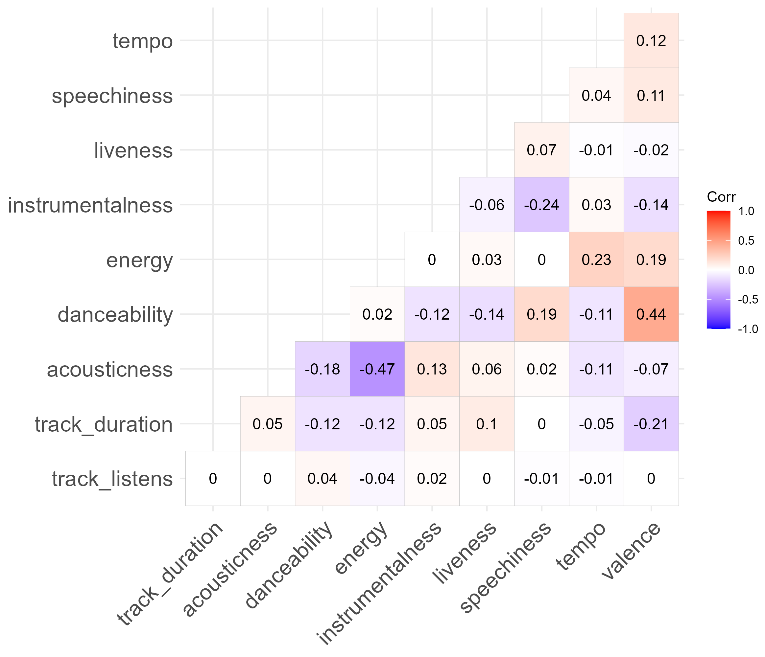
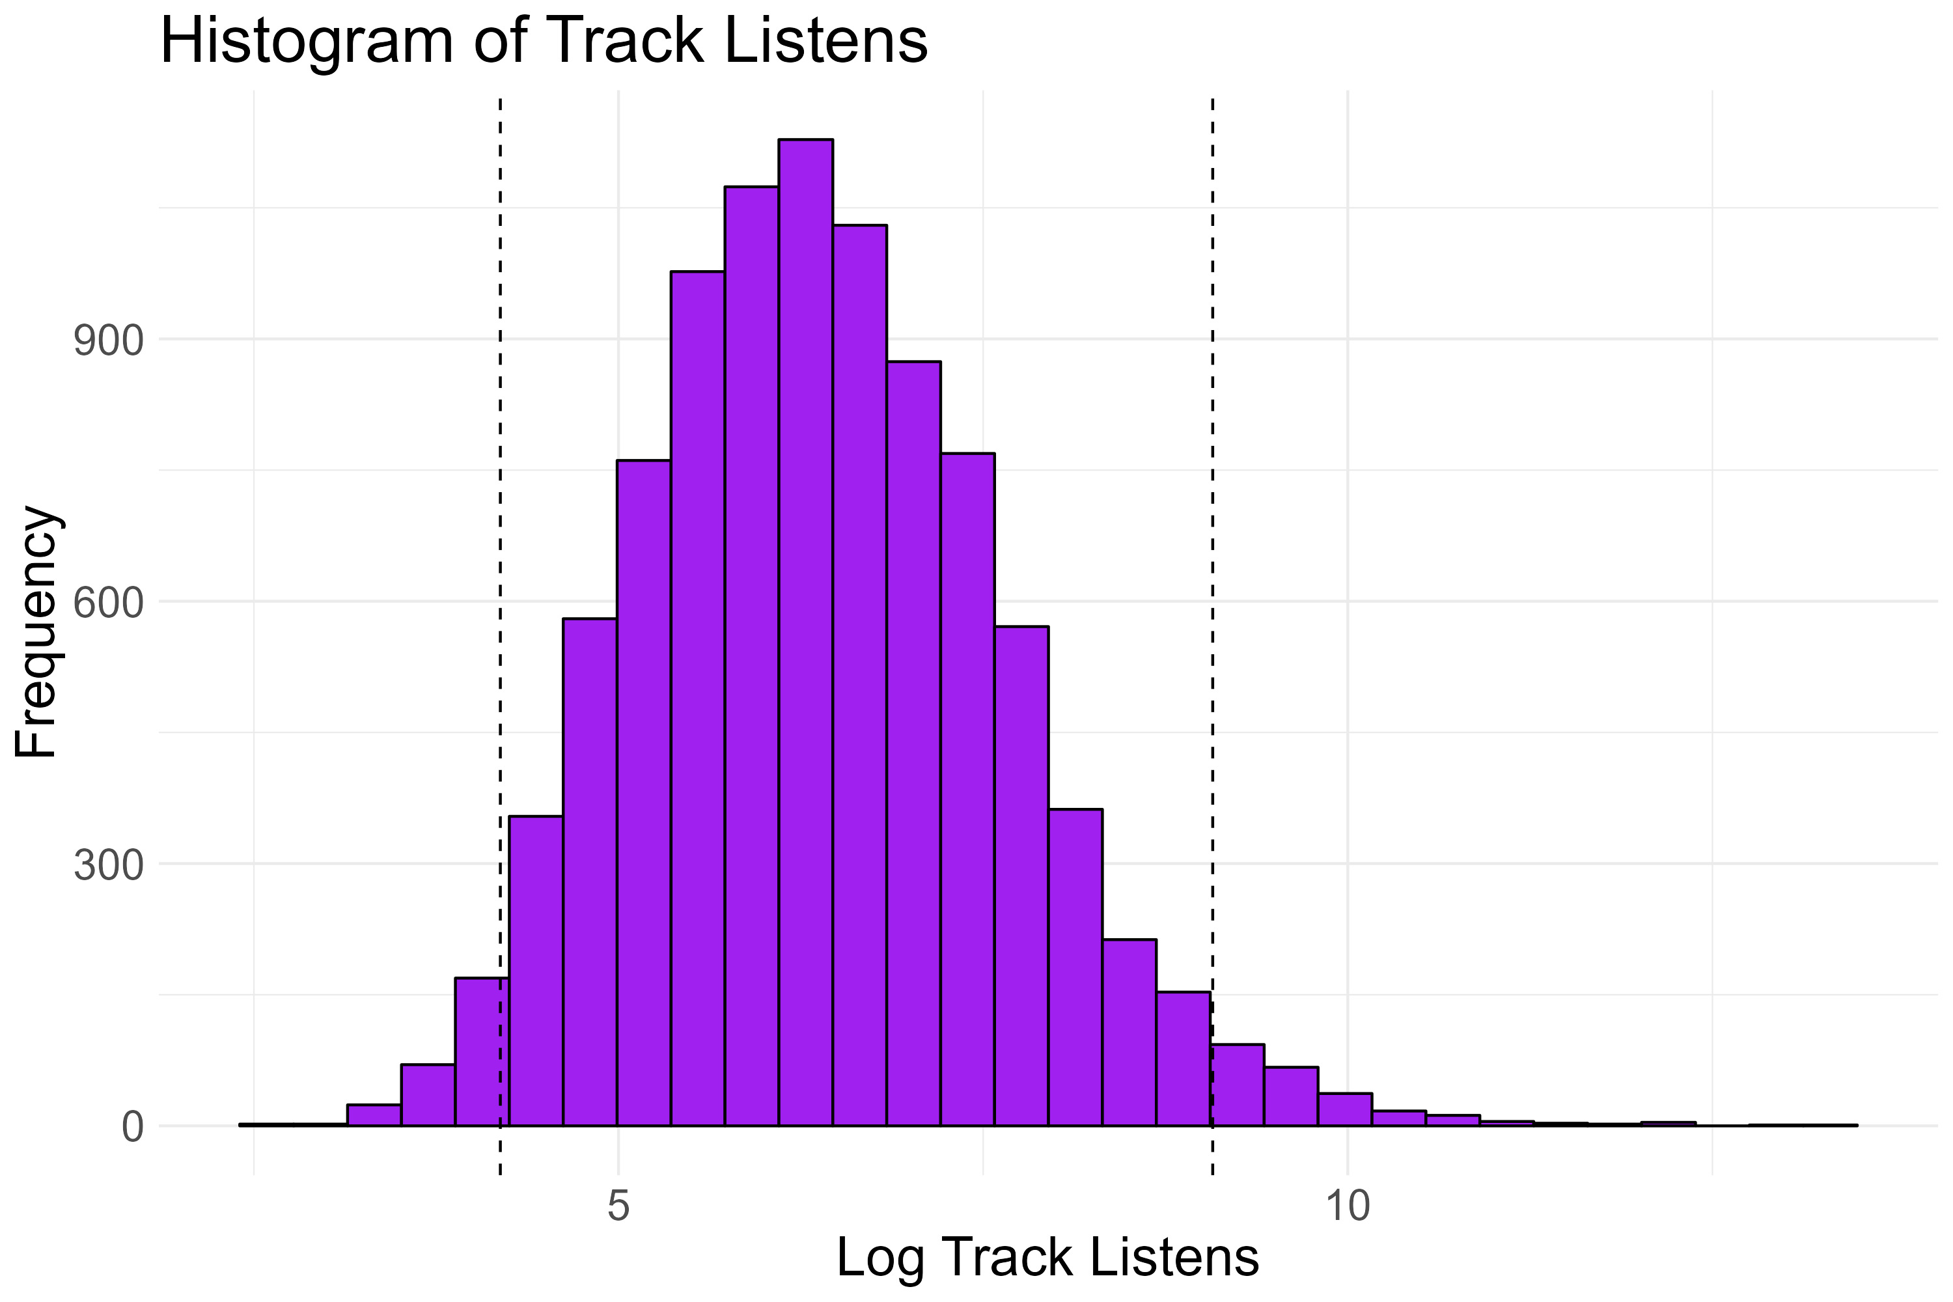
Data: Free Music Archive
The Free Music Archive (FMA) dataset is a publicly available collection of over 106,000 tracks, each annotated with metadata
  Popularity/success determined by the number of listens per track
  Bottom and top 2.5% removed
  ~9000 tracks included audio features extracted by Echo nest (Spotify’s music AI platform)
Notes:
My dataset I chose for this investigation is the Free Music Archive dataset, which is a publicly available collection of musical tracks
Each piece also has a number corresponding to the number of times listened. Because the number of listens grew exponentially, I applied a log transform to get the log number of listens.
With the log transform applied, there were no outliers, however, I chose to remove the most extreme 5% of the dataset.
Each piece also has metadata as well as acoustic features from Spotify’s web API feature extractions, listed in this correlation matrix here. As you can see, many of them are correlated.

Slide 5
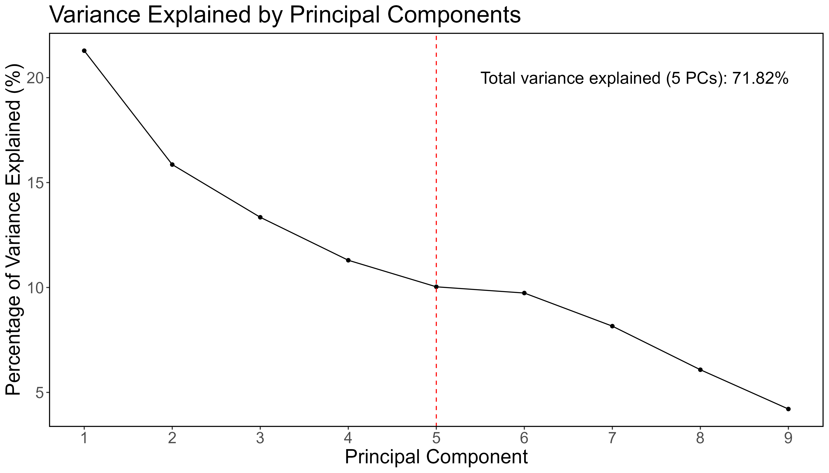
Methods: PCA
Principal Components Analysis used for dimensionality reduction
Used first 5 PCs as they explain ~72% of the total variance
  log_track_listens ~ PC1 + PC2 + PC3 + PC4 + PC5
Notes:
Since the eight acoustic features may have overlapping information, shown by the moderate correlations, I used dimensionality reduction using PCA. I chose to use the first 5 principal components as it explained around 72% of the variance, as adding more PCs showed diminishing returns.

Slide 6

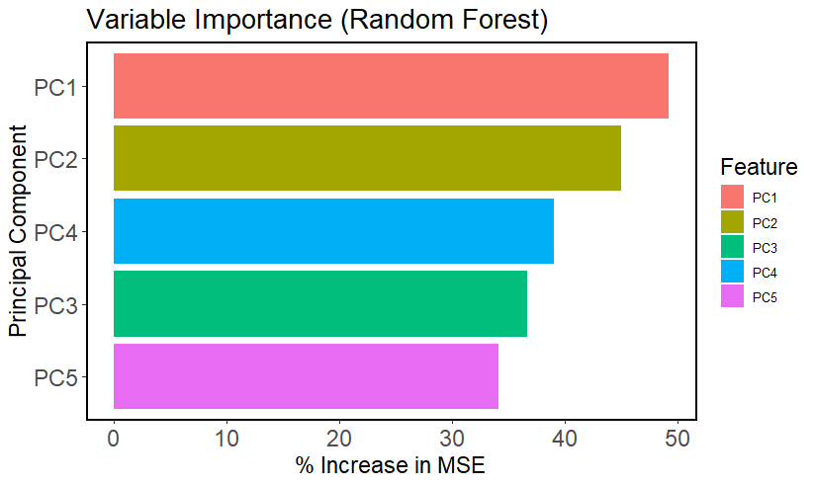
Methods: Models
Exploring the predictive power of PCs on music popularity using regression models
  80% for Training and 20% for Testing
  Model Evaluation using
    Feature (PC) Importance
    RMSE and R-squared
Random Forest Regression
Random Forest Parameter Tuning:
  500 Trees
  mtry = 1
Regression with Boosting
XGBoost Parameter Tuning:
  200 Trees (rounds of boosting)
  Tested depth from 1-5
  Minimizing test RMSE while using the lowest max_depth: depth of 3 at boost iteration 137
Notes:
As for the predictive models, I used an 80/20 split and compared the models using feature importance, RMSE, and rsquared
- The two models I chose were random forest regression and regression with boosting using xgboost

Slide 7
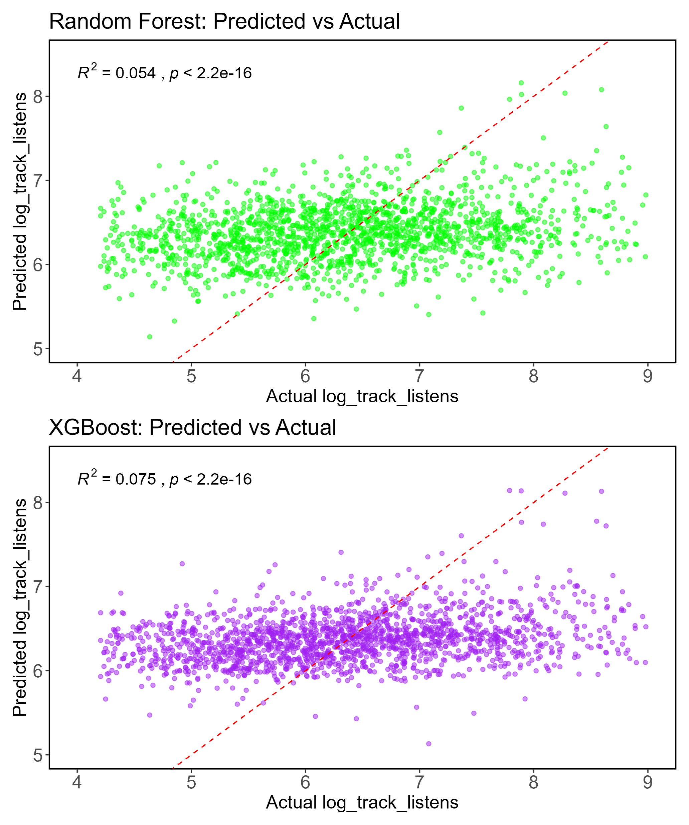
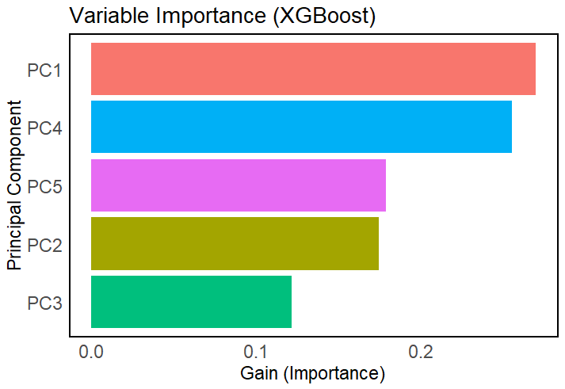
Results: Model Comparison & PCA Loadings
Random Forest Regression
RMSE: 1.043
R-squared = 0.054***
Most Important: PC1, PC2
Regression with Boosting
RMSE: 1.026
R-squared = 0.075***
Most Important: PC1, PC4
Notes:
Comparing the two models, the random forest regression had an rmse of 1.043 and a significant rsquared of 0.054. The two most important PCs for random forest was PC1 and PC2
The regression model with boosting had a slightly lower RMSE of 1.026 and a higher rsquared of 0.075. The most important loading was still PC1 but the next most important was PC4.

Slide 8
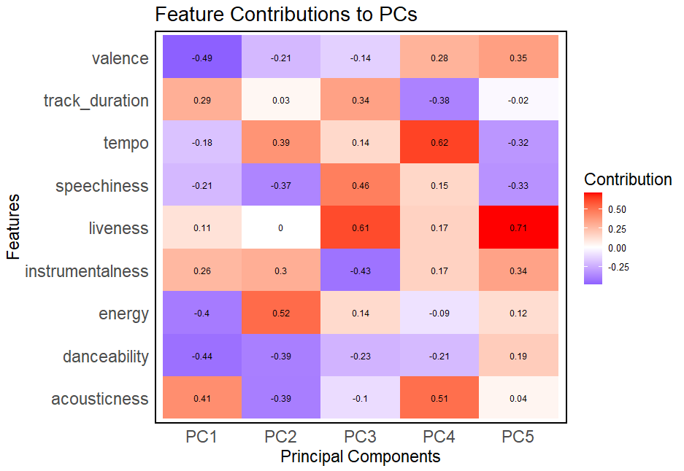

Discussion: PC and Feature Loadings
High RMSEs suggest that acoustic features alone cannot predict much variance in music preference, however, there was still a small significant association with the first 5 PCs on the number of listens the piece had in both models
Random Forest Regression
Regression with Boosting
Random Forest Regression
PC1: Low valence, low danceability, high acousticness
  Sad, slow, acoustic music
PC2: High energy & fast tempo, low danceability, low acousticness
  Fast, energetic, electronic music
Regression with Boosting
PC1: Sad, slow, acoustic music
PC4: Fast tempo, high acousticness, short duration
  Short, upbeat, acoustic music
Notes:
https://developer.spotify.com/documentation/web-api/reference/get-audio-features
Looking at the results, the relatively high RMSE and low rsquared for both models suggest that acoustic features alone cannot highly predict music preference
However, since there was enough power to still observe a small significant association between PCs and popularity, we can start to break that down.
PC1 grouped music that was sad, slow, and acoustic.
PC2 grouped music that was fast, energetic, and non-acoustic.
And PC4 grouped music that was shorter in duration, upbeat, and acoustic.

Slide 9
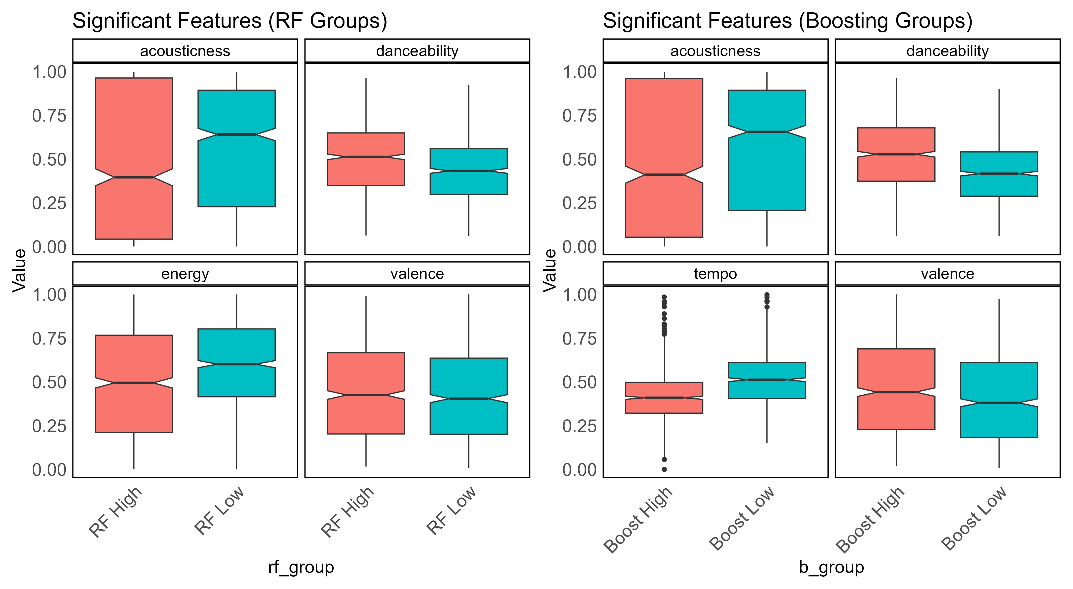
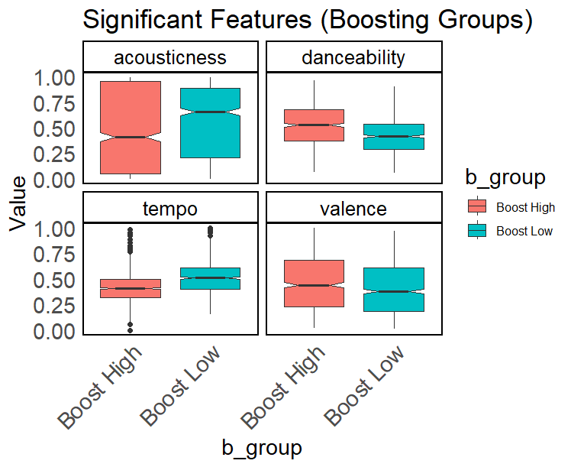
Discussion: PC and Feature Loadings
Random Forest Regression
Valence, Energy, Danceability, Acousticness
Regression with Boosting
Valence, Tempo, Danceability, Acousticness
According to the RF regression model, listeners prefer music with less acoustics, more danceable, moderate to low energy, and slightly more positive valence.
According to the boosting regression model, listeners prefer music with less acoustics, more danceable, moderate to slower tempo, and positive valence.
Notes:
https://developer.spotify.com/documentation/web-api/reference/get-audio-features
Further breaking down the 4 highest acoustic feature correlations with each model, we can get a better insight on how to better use these features to improve music preference.
Overall, the random forest regression showed that listeners preferred music that combined less acoustics, more danceable, lower energy, and more major or positive music.
Whereas the regression model with boosting showed that listeners preferred is a combination of less acoustics, more danceable, slower tempo, and positive major music.

Slide 10
Thank you!
Questions?

Slide 11
References
Chen, T., & Guestrin, C. (2016). XGBoost: A Scalable Tree Boosting System. In Proceedings of the 22nd ACM SIGKDD International Conference on Knowledge Discovery and Data Mining (pp. 785–794). New York, NY, USA: ACM. https://doi.org/10.1145/2939672.2939785
Defferrard, Michaël, Kirell Benzi, Pierre Vandergheynst, and Xavier Bresson. 2016. “FMA: A Dataset for Music Analysis.” arXiv Preprint arXiv:1612.01840.
Ellis, Daniel PW, Brian Whitman, Tristan Jehan, and Paul Lamere. 2010. “The Echo Nest Musical fingerprint.”
Liaw A, Wiener M (2002). “Classification and Regression by randomForest.” R News, 2(3), 18-22. https://CRAN.R-project.org/doc/Rnews/.
Lin, Ning, Ping-Chia Tsai, Yu-An Chen, and Homer H Chen. 2014. “Music Recommendation Based on Artist Novelty and Similarity.” In 2014 IEEE 16th International Workshop on Multimedia Signal Processing (MMSP), 1–6. IEEE.
R Core Team. 2020. R: A Language and Environment for Statistical Computing. Vienna, Austria: R Foundation for Statistical Computing. https://www.R-project.org/.
Wickham H, Averick M, Bryan J, Chang W, McGowan LD, François R, Grolemund G, Hayes A, Henry L, Hester J, Kuhn M, Pedersen TL, Miller E, Bache SM, Müller K, Ooms J, Robinson D, Seidel DP, Spinu V, Takahashi K, Vaughan D, Wilke C, Woo K, Yutani H (2019). “Welcome to the tidyverse.” Journal of Open Source Software, 4(43), 1686. doi:10.21105/joss.01686.
Zhang, Jurui, Shan Yu, Raymond Liu, Guang-Xin Xie, and Leon Zurawicki. 2024. “Unveiling the Melodic Matrix: Exploring Genre-and-Audio Dynamics in the Digital Music Popularity Using Machine Learning Techniques.” Marketing Intelligence & Planning

